Slide 1
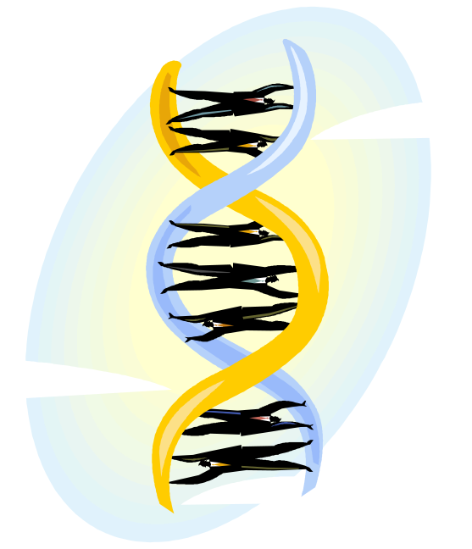
Genetic Algorithms
Tackling Intractable Problems

Slide 2
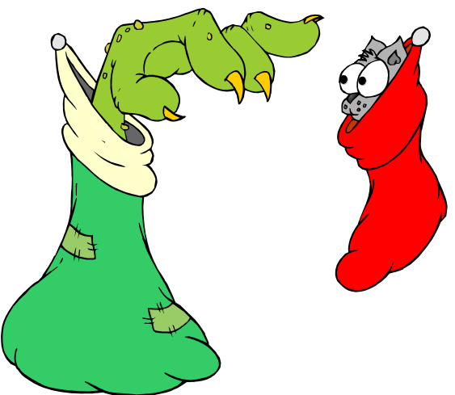
Genetic Algorithms
Genetic Algorithms use models of biological evolution to solve problems.
Genetic Algorithms work best for:
Intractable (exponential) problems or ones with large state spaces
Problems with many solutions that may be improved over time
Problems for which a suboptimal answer is sufficient
In general, Genetic Algorithms are:
Not Systematic
Informed
Not Optimal
Not Complete
Not Exhaustive

Slide 3

Genetic Algorithms
Breakdown
Genetic Algorithms Vocab:
A chromosome (or genome) is a potential solution.
A gene is an attribute or feature of a solution.
The numeric fitness of a chromosome is its level of “optimality.”
Three main steps in Genetic Algorithms:
Selection is the process of choosing which individuals reproduce.
Recombination is the process of creating offspring chromosomes.
Mutation is the process of introducing changes to solutions.

Slide 4

Genetic Algorithms
Selection
Reproductive selection is based on the fitness of individuals & selection method.
Fitness:
Is some numeric measure of the goodness of a chromosome.
Is used to rank available chromosomes against one another.
Measures the solutions as a whole, rather than single genes.
Is usually calculated using a fitness function.
Selection Methods
Ranked Selection
Proportional Selection
Tournament Selection
Random Sample Selection
Selection methods may also include an elitist selection.

Slide 5
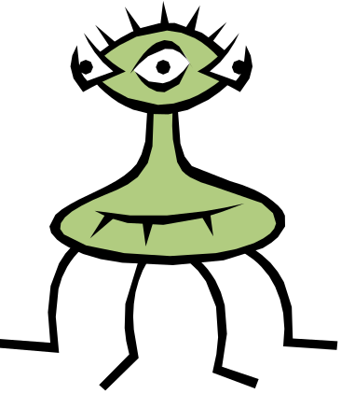

Genetic Algorithms
Recombination & Mutation
Once two chromosomes are selected to reproduce, they must generate offspring.
Two Recombination Methods:
Single-point Crossover
Multipoint Crossover
During the process of reproduction, anomalies can be introduced via mutation.
Some Mutation Methods:
Modification
Duplication
Insertion
Deletion

Slide 6
Genetic Algorithms
Mutation
Examples
Modification
Insertion
Duplication
Deletion

Slide 7
Genetic Algorithms
Implementation
Steps to Genetic Search:
Generate a random pool of chromosomes.
Calculate the fitness of all chromosomes.
If finished:
  Return best candidate as solution.
Otherwise:
  Use selection method to select candidates.
  Generate offspring pool from the candidates.
  Mutate genes of the offspring generated in B).
  Optionally, move best parent(s) to offspring pool.
  Discard parent pool.
  (Alternately, you can keep most parents and only replace a few. This is steady-state reproduction.)
  Go to step 2.
class Gene
{
datatype data;
}
class Chromosome
{
double fitness;
list<Gene> genes;
}

Slide 8
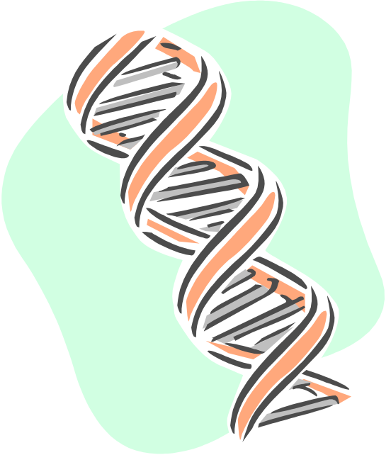
Genetic Algorithms
Benefits & Drawbacks
Benefits
Capable of producing surprising emergent behavior
Don’t require hand-coding
Can be applied to very large state spaces
Flexible and adaptable
Drawbacks
Very poorly suited for some applications
Random and therefore unpredictable
Hard to debug – is it broken, or just not evolved yet?
Tuning can be time-intensive and may have to be done many times
Diminishing returns
Genetic algorithms are used sparingly in games, usually employed as an offline technique (like the bots in Quake 3) and are often used to tune parameters of an algorithm.

